Slide 1

Online Multiplayer Chess Game
Name: Jagadish Parajuli
Un ID: 21422012

Slide 2

Introduction
A project for developing online gaming platform for chess players.
Promote online chess by providing features essential for improving chess tactics.

Slide 3

Aims
The aim of this project are listed below:
Provide platform for better online chess gaming experience
Promote online gaming interaction among players
Provide proper Analysis tool

Slide 4

Objectives
Development of engaging UI with(HTML, CSS and JavaScript)
Using MYSQL for maintaining users and match details.
Implementing Laravel for handling backend.
Using WebSocket for real time communication for multiplayer matches.
Using Stockfish for match analysis.

Slide 5
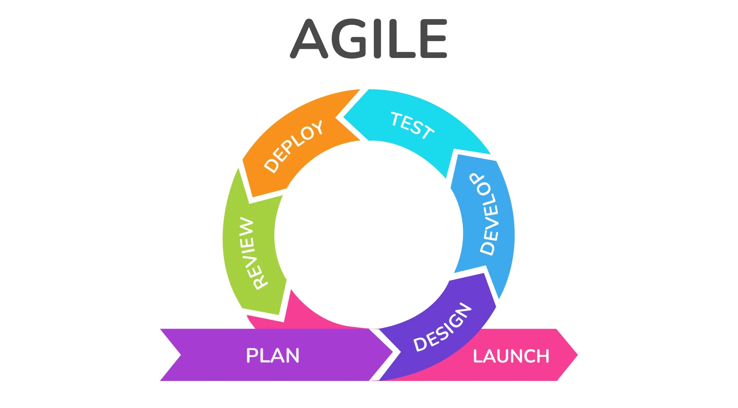
Methodology: Agile

Slide 6
Problem Domain
UI Design(Chess Board)
Usability of Analysis Tool
Variety of Game Mode

Slide 7
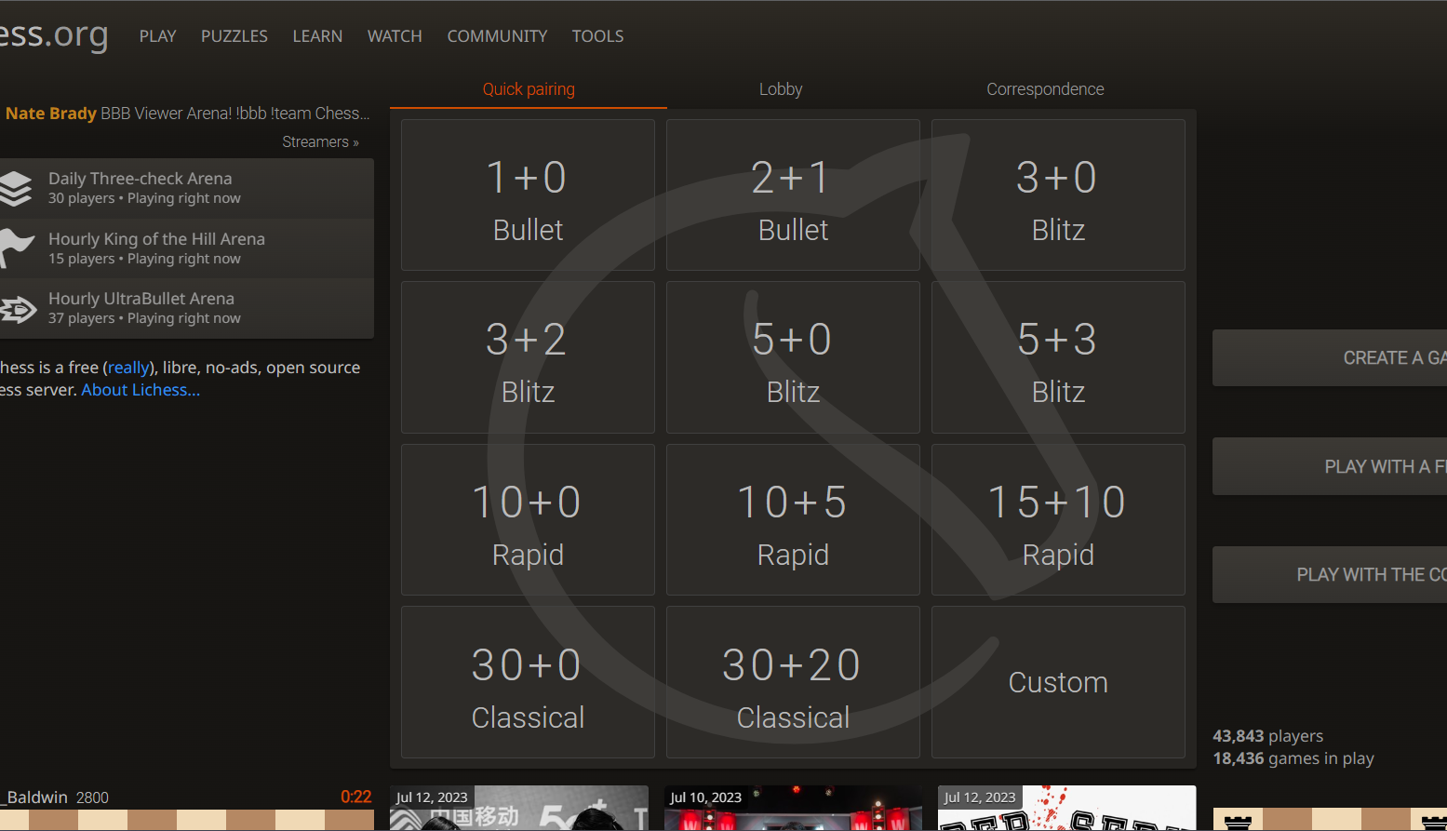
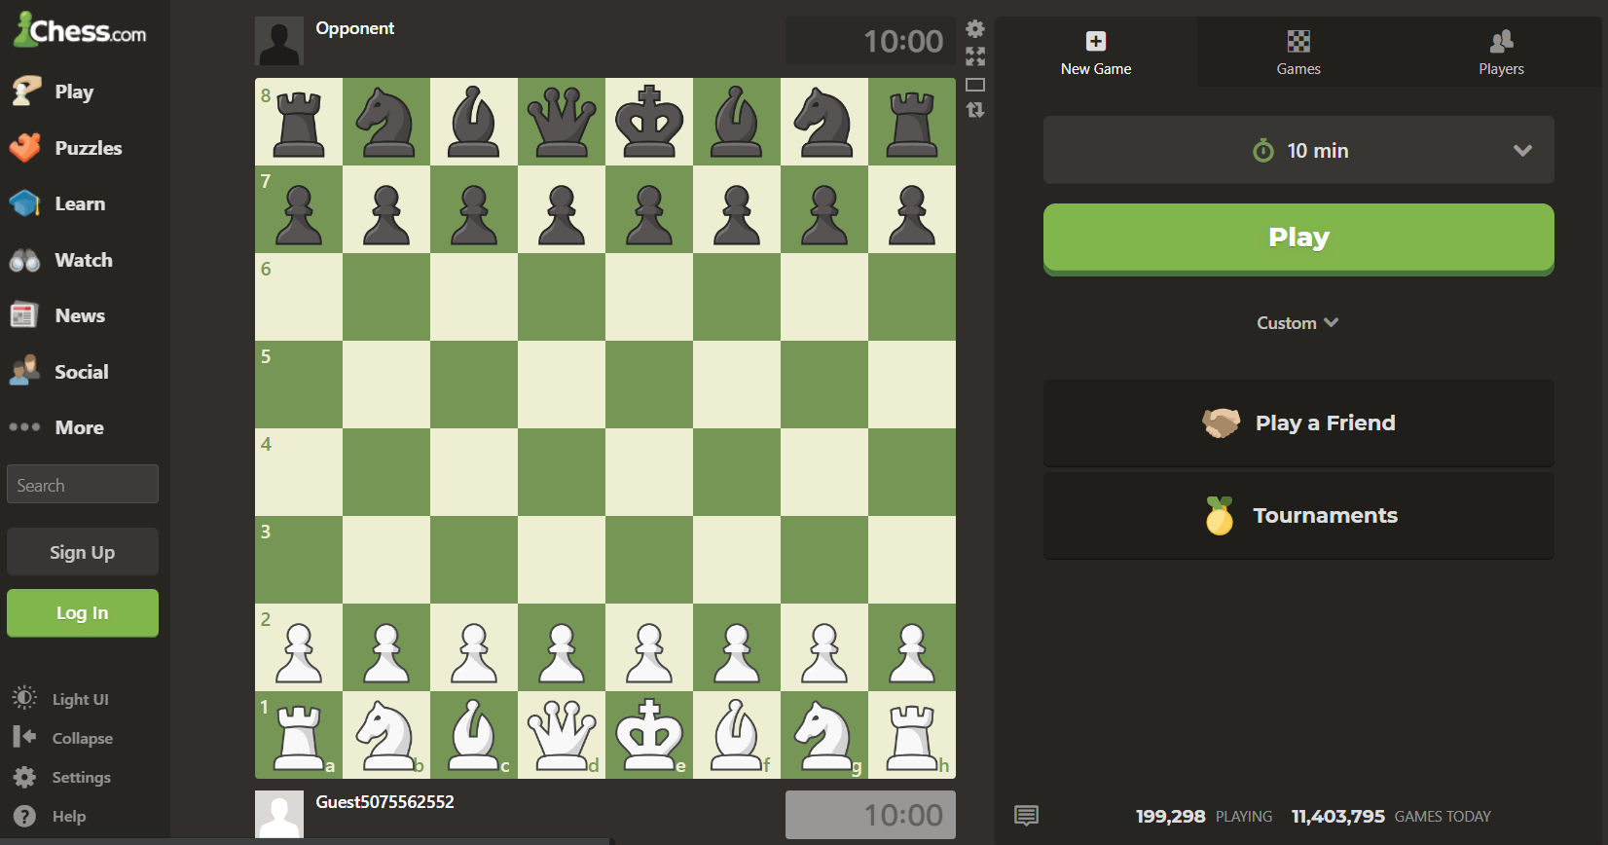
Comparable System
Lichess.org
Chess.com

Slide 8

FEN Position in Chess
Full form: Forsyth-Edwards Notation
Used for defining any chess positions
Foundation of my chess program

Slide 9
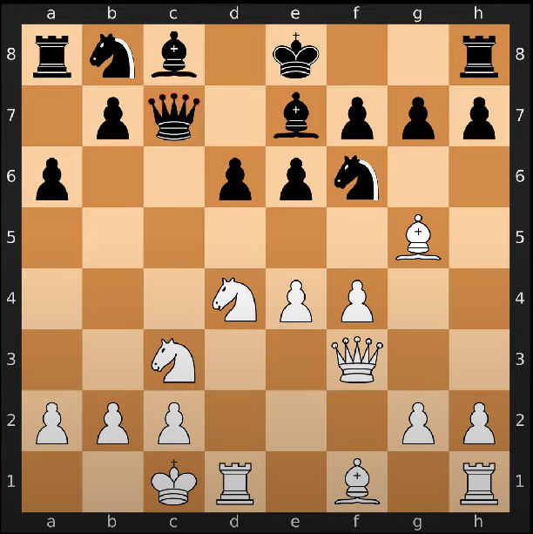
Chess Position in Board

Slide 10
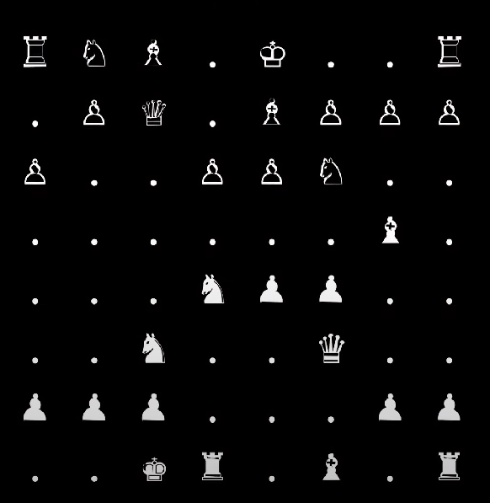
Representing: Board and Empty Squares

Slide 11
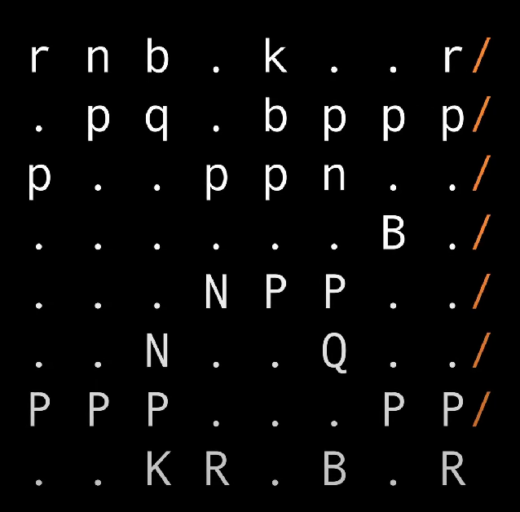
Representing white and black pieces

Slide 12
Board Position in text
rnb.k..r/.pq.bppp/p..ppn../……B./…NPP../..N..Q../PPP…PP/..KR.B.R
Counting Empty squares:
rnb1k2r/1pq1bppp/p2ppn2/6B1/3NPP2/2N2Q2/PPP3PP/2KR1B1R

Slide 13
FEN: Whose turn to move
rnb1k2r/1pq1bppp/p2ppn2/6B1/3NPP2/2N2Q2/PPP3PP/2KR1B1R w

Slide 14
FEN: Castling Premising
rnb1k2r/1pq1bppp/p2ppn2/6B1/3NPP2/2N2Q2/PPP3PP/2KR1B1R w KQkq

Slide 15
FEN: En-passant
Square Number of targated location
rnb1k2r/1pq1bppp/p2ppn2/6B1/3NPP2/2N2Q2/PPP3PP/2KR1B1R w KQkq -
Might have square number like: e4, a5

Slide 16
FEN: Half move and Overall move
If no pawn move, no capture or no check it is regarded as half move.
If both player makes a move it is counted as one overall move
rnb1k2r/1pq1bppp/p2ppn2/6B1/3NPP2/2N2Q2/PPP3PP/2KR1B1R w KQkq – 4 9

Slide 17

Chess Engine: Stockfish
Based on min-max and alpha beta pruning algorithms
Number of depth
Total possibilities: 10 to the power 123(infinite)

Slide 18
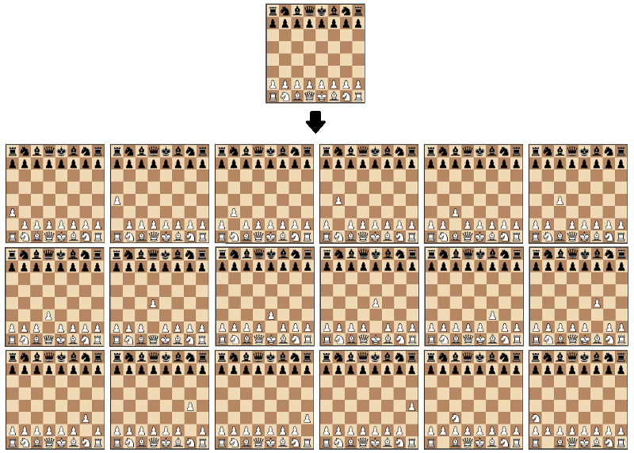
Stockfish: Min max, number of possibilities

Slide 19
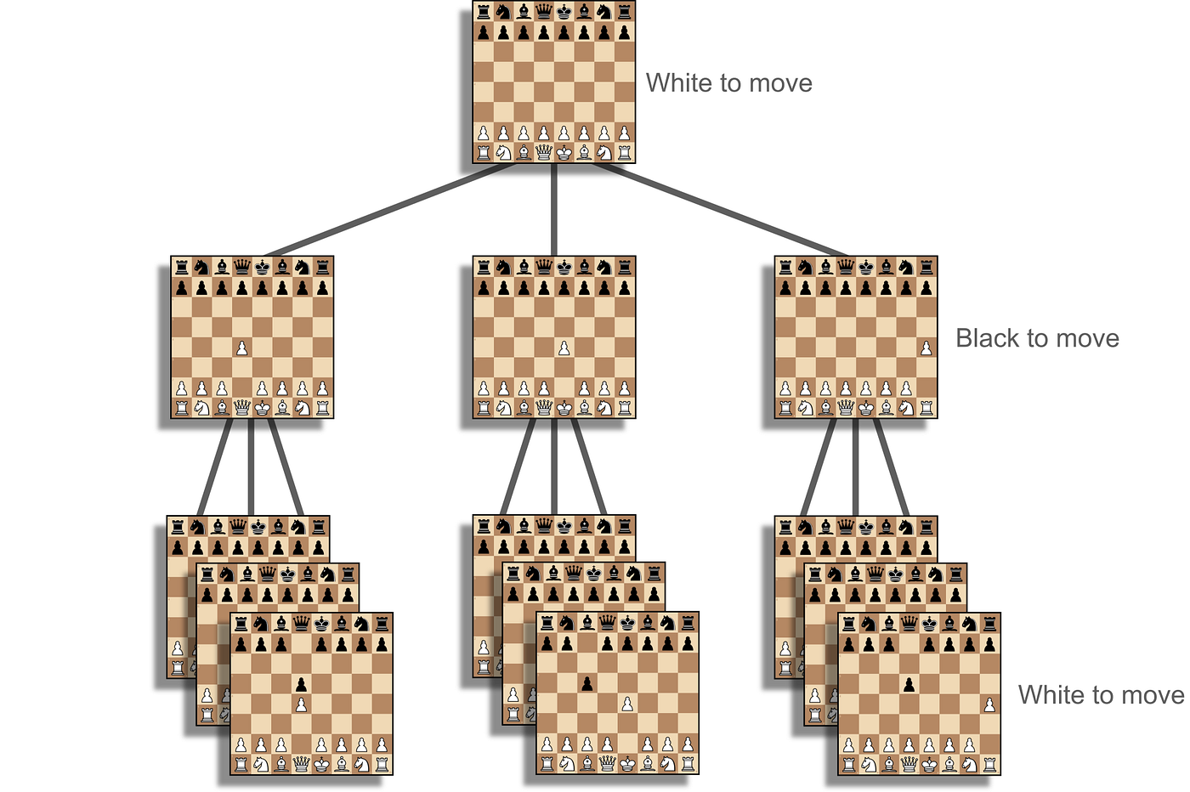
Stockfish: Min-max

Slide 20
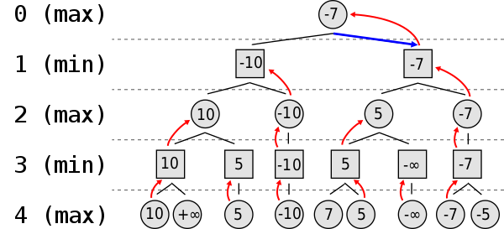
Stockfish: Minmax Choosing best move

Slide 21
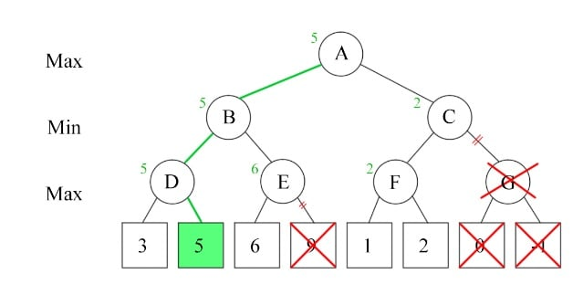
Stockfish: Alpha beta pruning

Slide 22
Rules of Chess Implemented
Movement for all Pieces and capture
Check checkmate and stalemate
Pinned Pieces
En-phasant move
Pawn promotion
Stalemate in 50 moves

Slide 23

System Analysis and Design
After analysis system architecture are created using:
Class Diagram
Use Case Diagram
Sequence Diagram

Slide 24
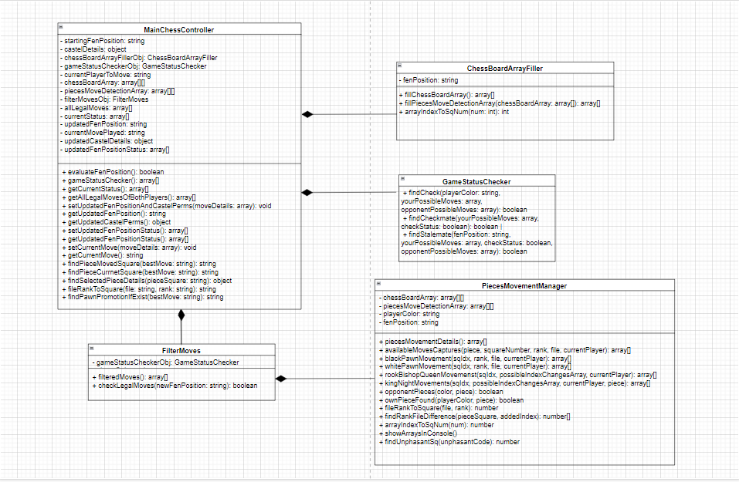
Class Diagram Of Chess Game Play

Slide 25
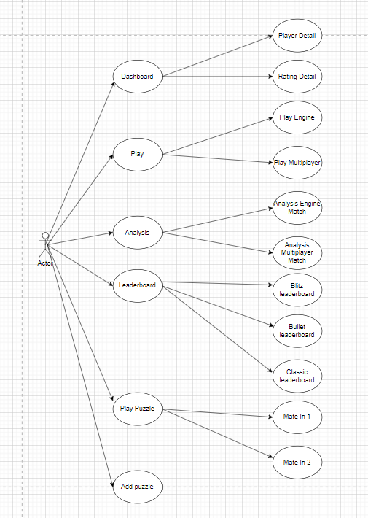
Use Case Diagram

Slide 26
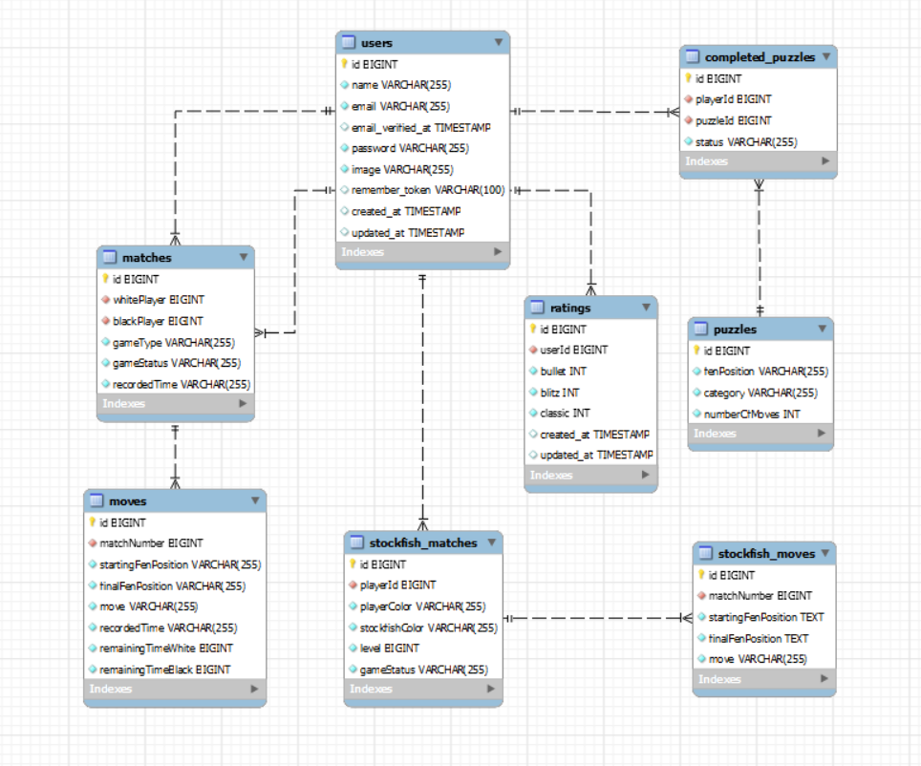
ERD Diagram

Slide 27
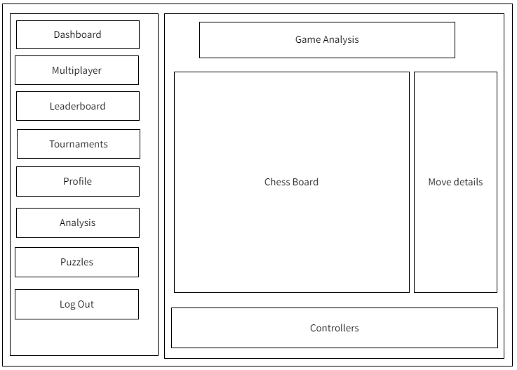
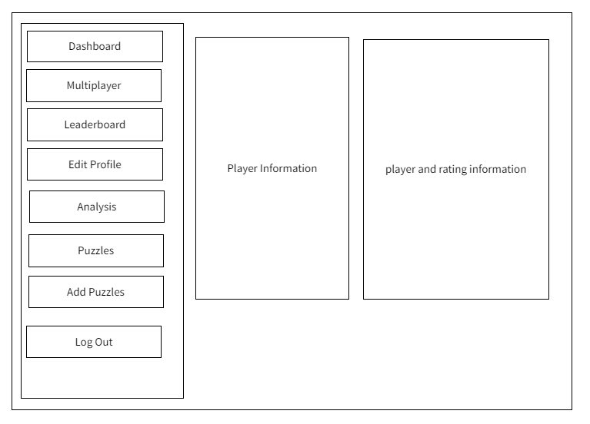
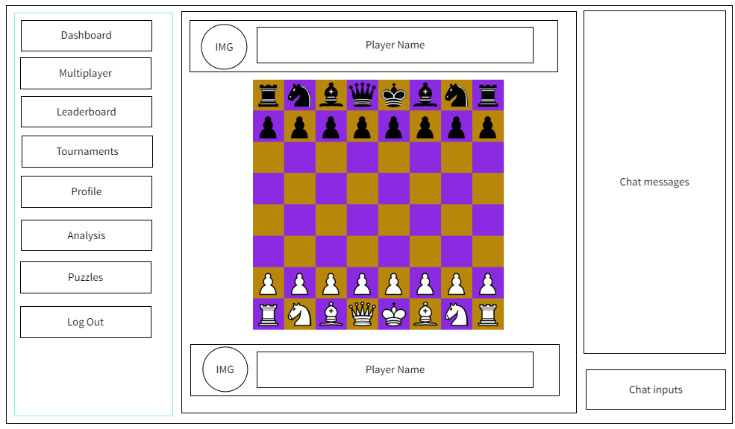
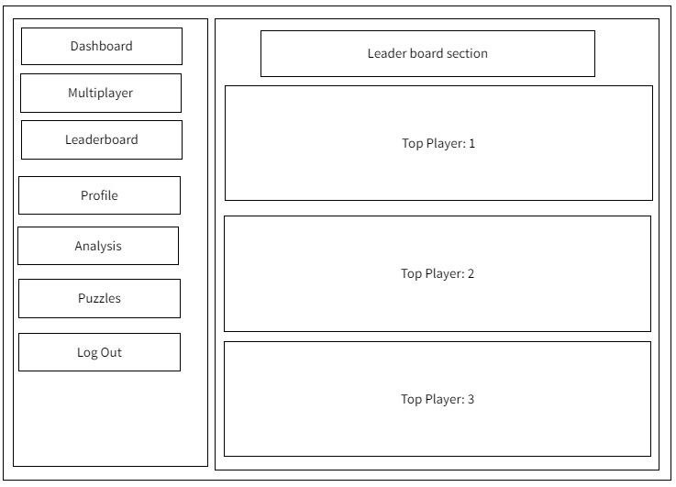
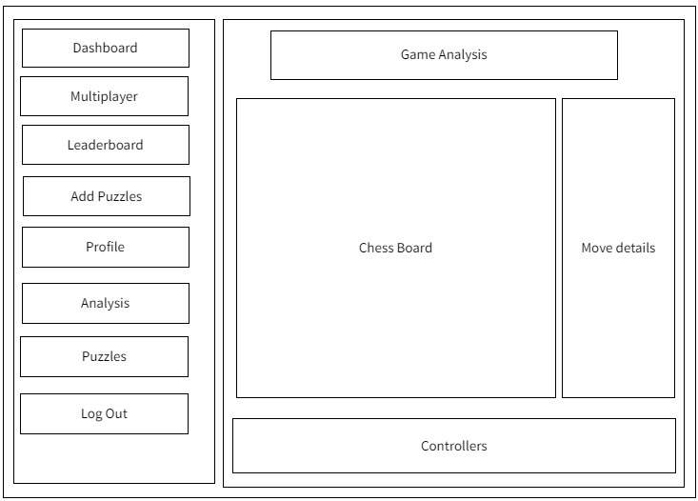
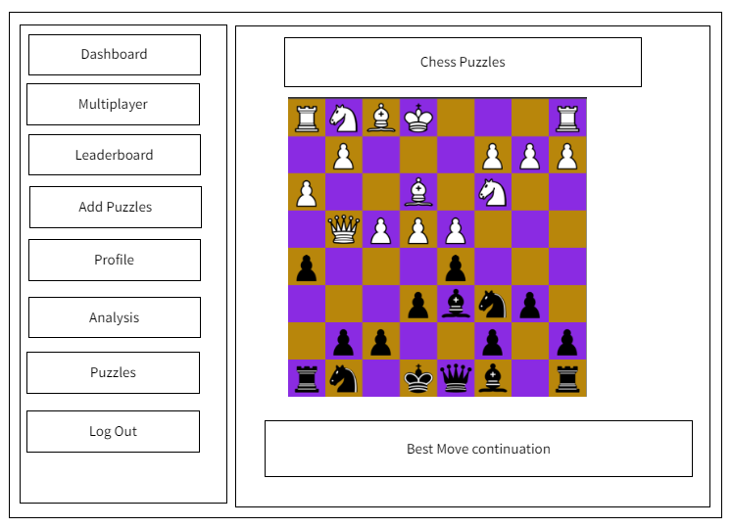
Wire Frame and mockups
Following wire frames were produced:

Slide 28
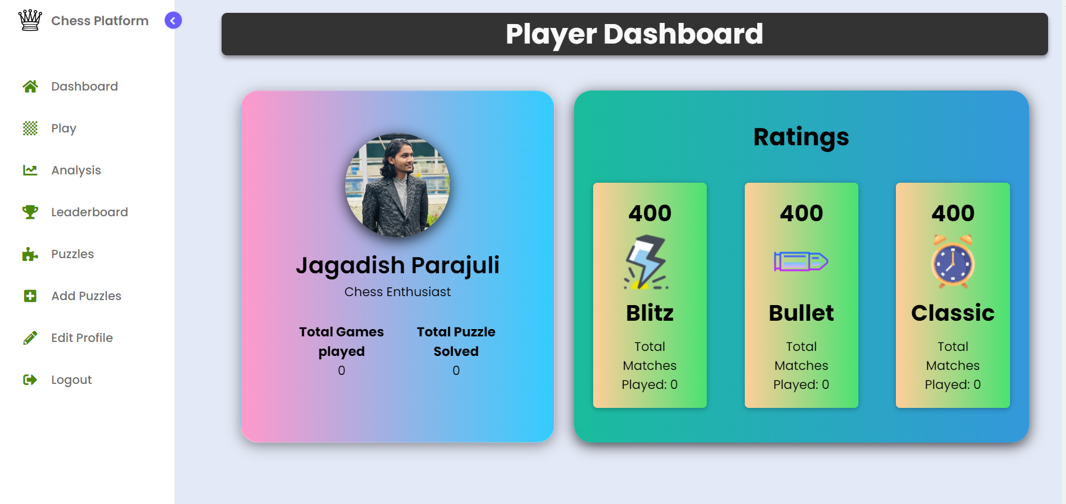
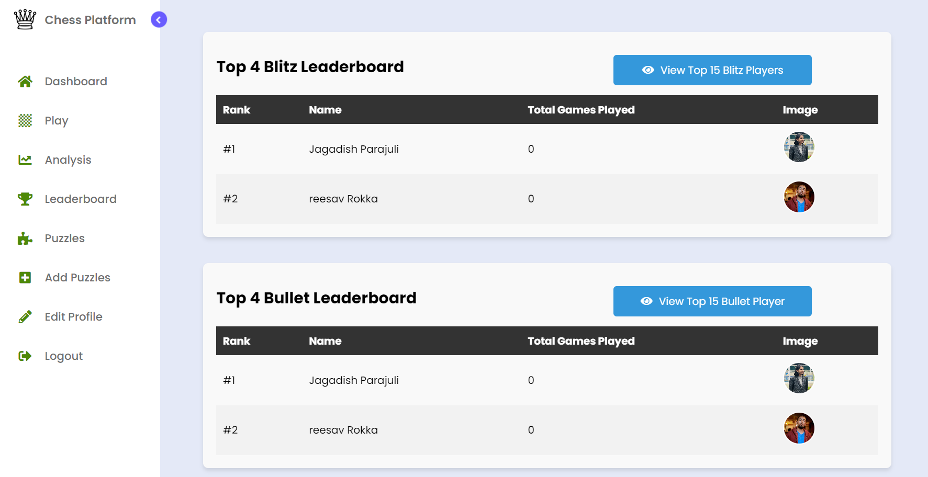
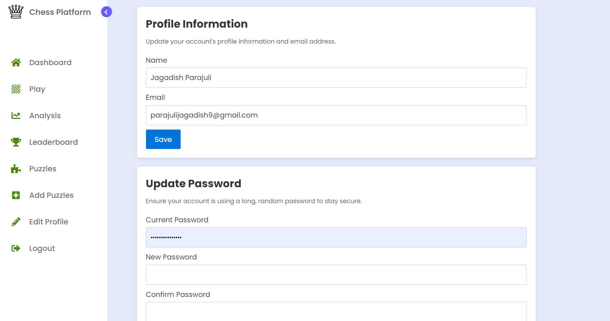
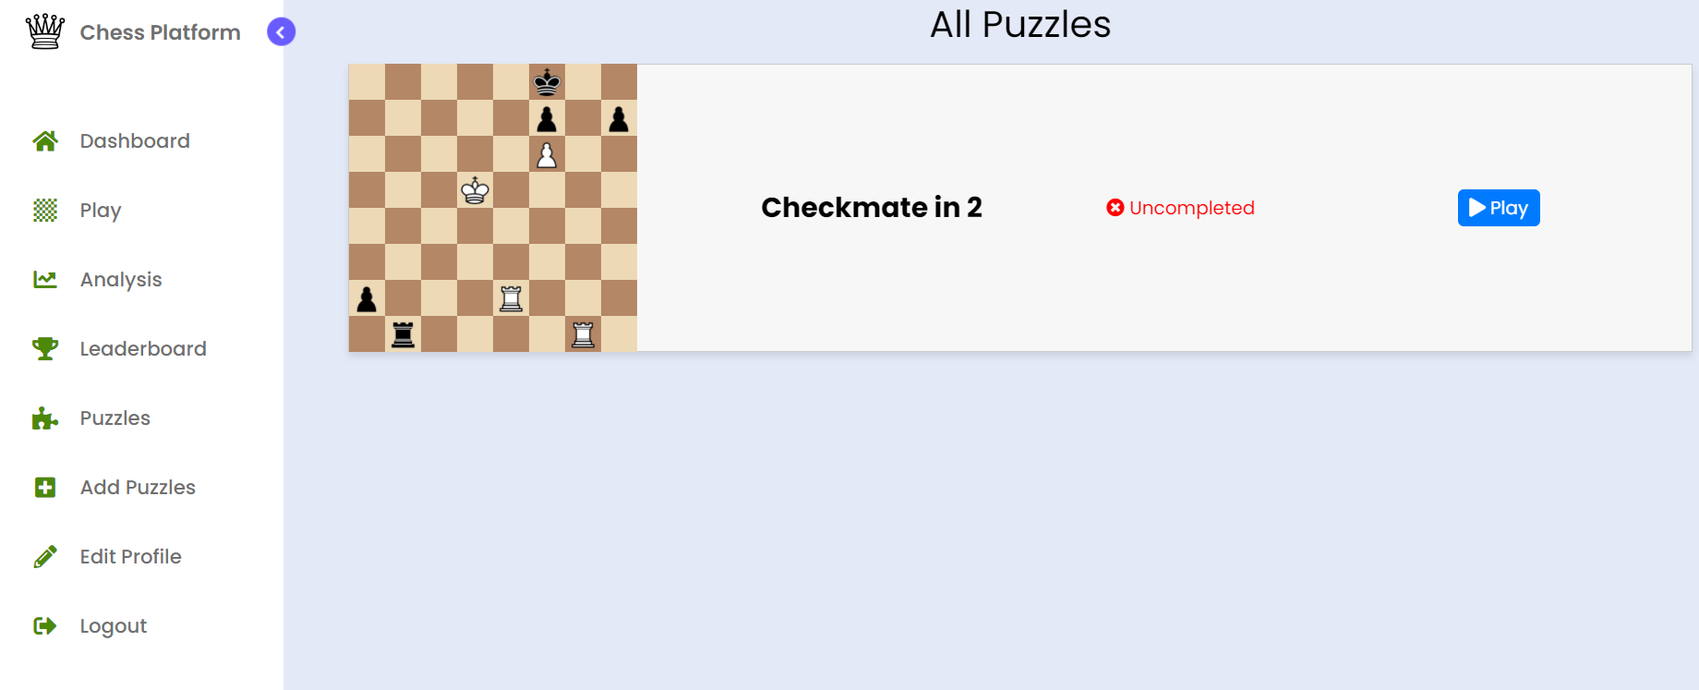
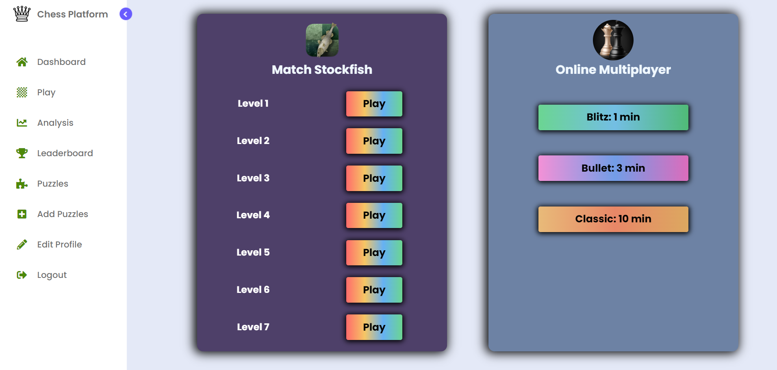
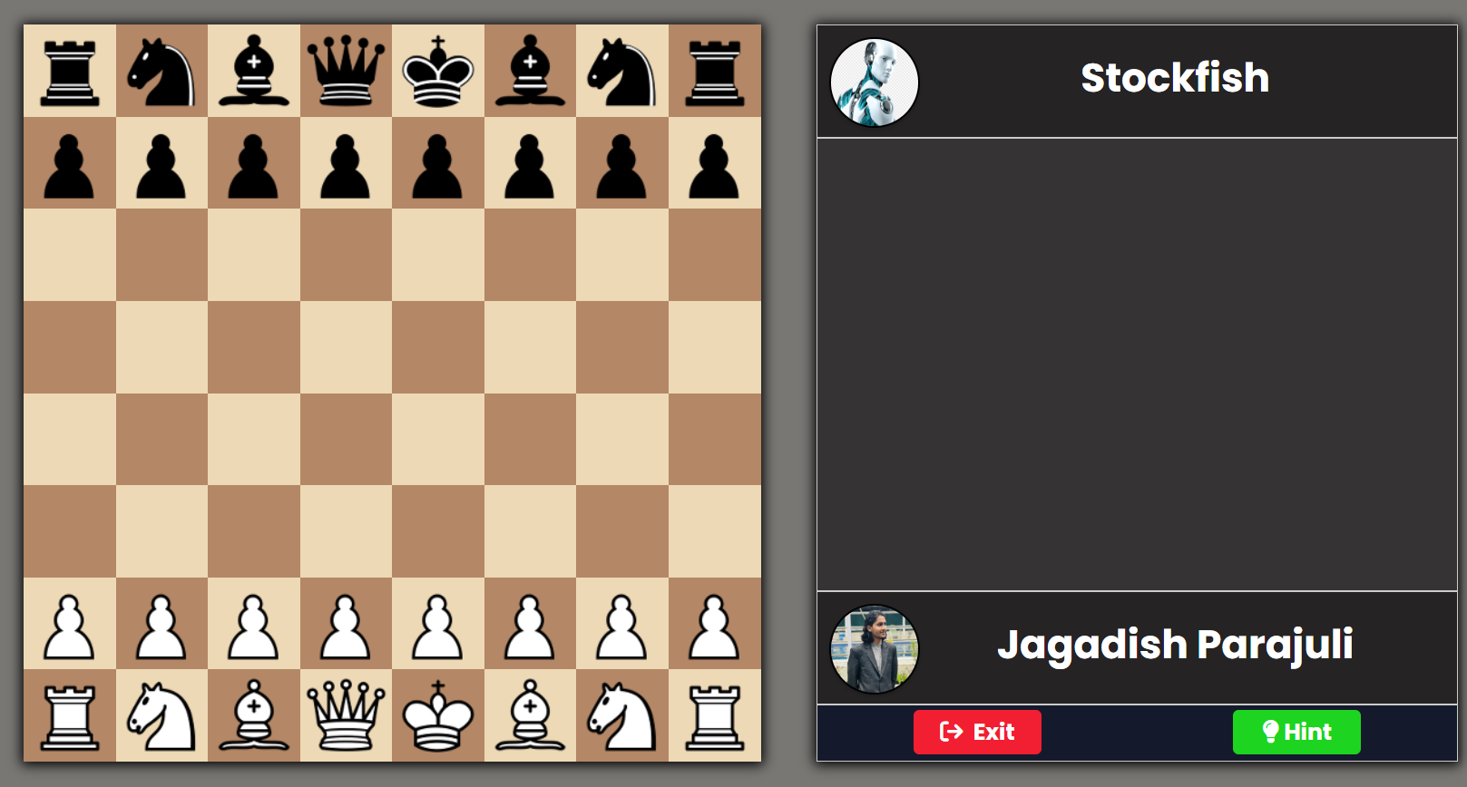
Wire Frame and Mockups
Following mockups were produced:

Slide 29
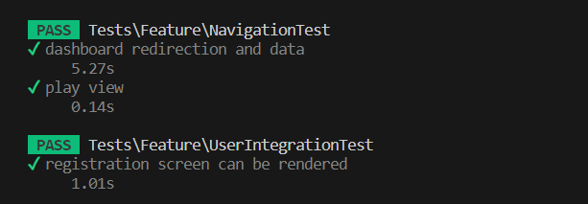
System Testing
Unit testing
For Features testing
Integrating testing

Slide 30
Conclusion
With internet and technology, popularity of chess is increasing day by day
Chess.com and lichess.org has more than million games played every day
Such platforms can be very competative

